Slide 1

Quote Me
Kyo Sook Shin, Andre Nurwono, Megan Wright,
Charles Huurman, Emily Knight and Davon Rooks

Slide 2
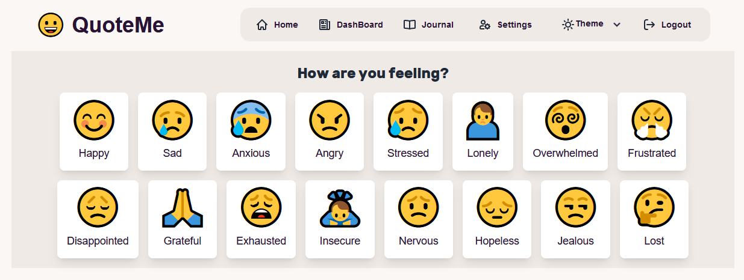
OVERALL CONCEPT
QuoteMe is a web application designed to enhance emotional well-being through personalized affirmations, shared mindfulness experiences, and private journaling.
When you first log into the page, you are taken to a page that has a variety of emotions, when you click on the emotion you are feeling in the moment, the app will give you 3 affirmations to lift you up! You also have the option to save any of those quotes to your journal to keep with you. At the top of the page is a navigation bar where you can create your own quotes and share them, as well as view other peoples quotes in the dashboard, or make then private which will then save your created quote to your journal.

Slide 3
MOTIVATION
Our motivation was to create a platform that fosters a supportive community for individuals to reflect on their feelings, find motivation, and connect with others on a similar journey. Most of the popular applications these days are very negative, just look at the comments! We want to make connecting with others on the internet a more supportive, uplifting and sincere experience! Normalizing mental-health awareness is very important and we believe connecting with and supporting each other, as well as journaling and self-reflection is very important.

Slide 4
TASKS
Charles - Prototyping w/ Figma, Colors, Responsive UI Refinement, Fix UI
Megan - Generated Affirmations and Emotion Selection (react<->db) + seeding affirmations
Andre - Backend db implementation, OpenAI analysis of quote, Journal/Dashboard, seed data
Kyo - Backend db implementation, Emotion chart from chartjs - Fixing bugs - generate images
Emily - Create Quote frontend and general direction
Davon - Assisting everyone with commits, etc

Slide 5
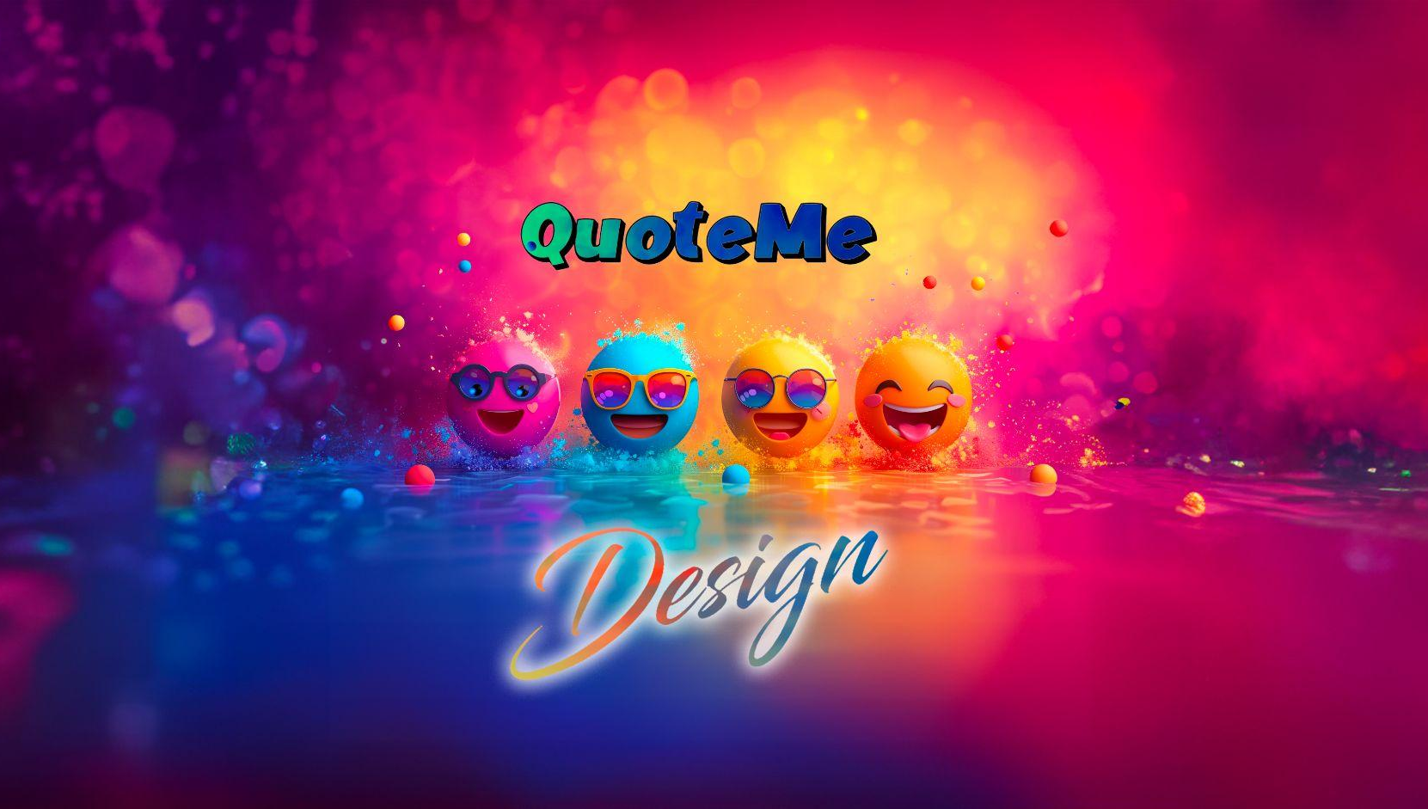
MOTIVATION
Our motivation was to create a platform that fosters a supportive community for individuals to reflect on their feelings, find motivation, and connect with others on a similar journey. Most of the popular applications these days are very negative, just look at the comments! We want to make connecting with others on the internet a more supportive, uplifting and sincere experience! Normalizing mental-health awareness is very important and we believe connecting with and supporting each other, as well as journaling and self-reflection is very important.

Slide 6

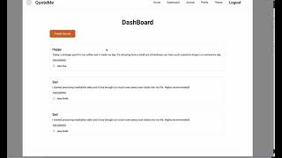
MOTIVATION

Slide 7
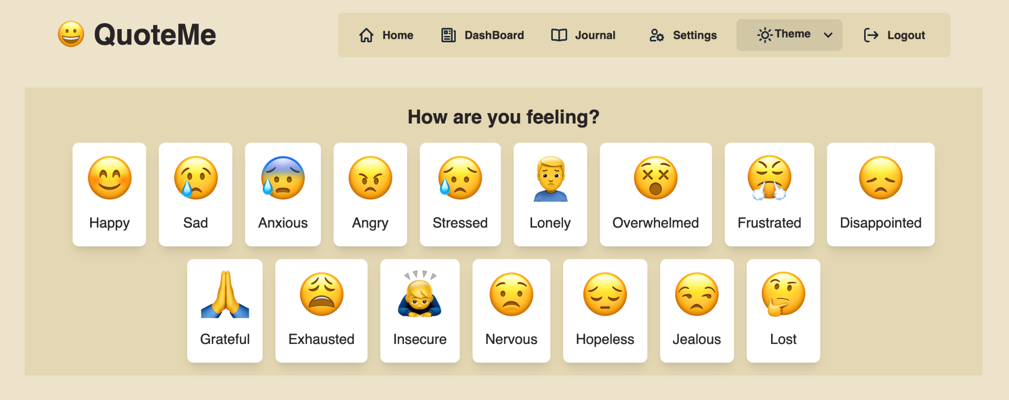
Design Philosophy & Emojis 😀 🥰 😤 🤪 🤯

Slide 8
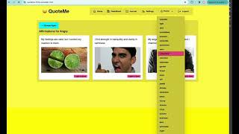
Themes

Slide 9
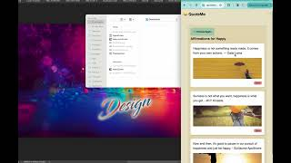
Mobile 😀

Slide 10
Find code patterns and code parts that fulfill the desired features: Use the MERN code pattern (Stu 26) as code scaffolding to quickly prototype the backend
Backend development (data structure, GraphQL resolvers and typedefs) are needed before the front-end can accelerate
Each of us observed and learned what others have coded to align our vision together and improve the product from our individual perspectives
Changes are sometimes discussed and rejected due to bugs (ie. .gitignore missing, .env missing, malicious typesquatted package appearing on repo)
Continuous improvement cycle (aka. Things can also suddenly change when someone thinks they need to change - probably akin to Agile?)

Slide 11
TECHNOLOGIES USED
MongoDB
React
Apollo/GraphQL
Jsonwebtoken(JWT)
Stripe
Node/Express
DaisyUI / TailWind CSS
Bcrypt
Axios
Vite
OpenAI
Chart.js, react-chartjs-2
Pixabay api to fetch pictures related with emotion

Slide 12
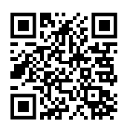
DEMONSTRATION
https://quoteme-1b7p.onrender.com/

Slide 13
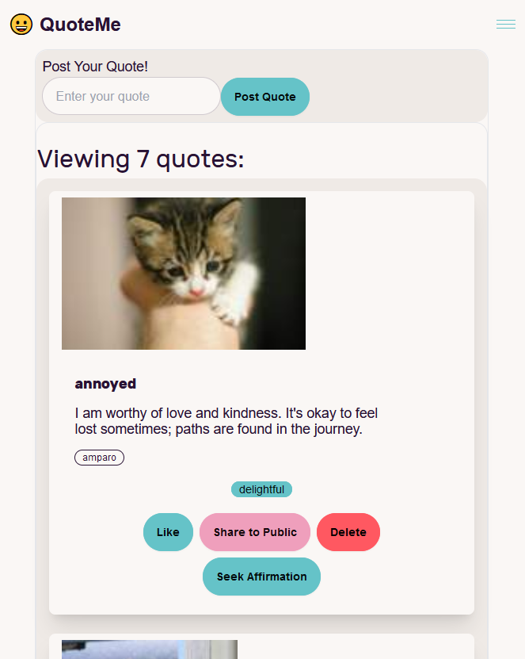
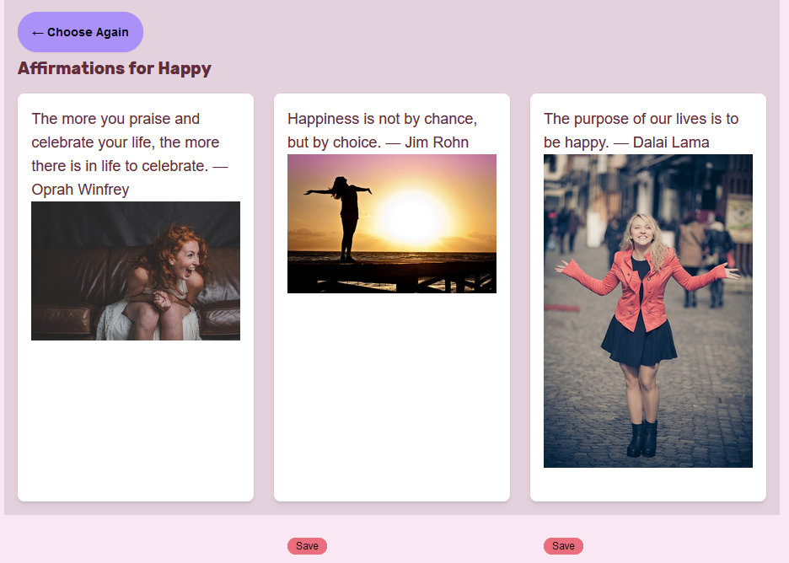
DEMONSTRATION
https://quoteme-1b7p.onrender.com/

Slide 14
FUTURE DEVELOPMENT
Implementing different subscription options that offer more functionality and/or options for your application
Adding more functionality to the journal tab/section so you can actually journal if you like, keep track of how often you journal or the page can generate journal prompts for you
App functionality that keeps track of which emotions you click on and on which day you clicked that emotion so you can keep track of your emotions and look back on them to see how your week went or just to reflect!
Games with AI, personality tests
Extend emotionChart to monthly or yearly emotion data trace

Slide 15
THANK YOU!

